Slide 1
Microsoft Dynamics 365 and Power Platform Conference

Slide 2
Unleashing the Code of Chaos
Nathan Clouse
Technical Architect
Caf2Code LLC

Slide 3

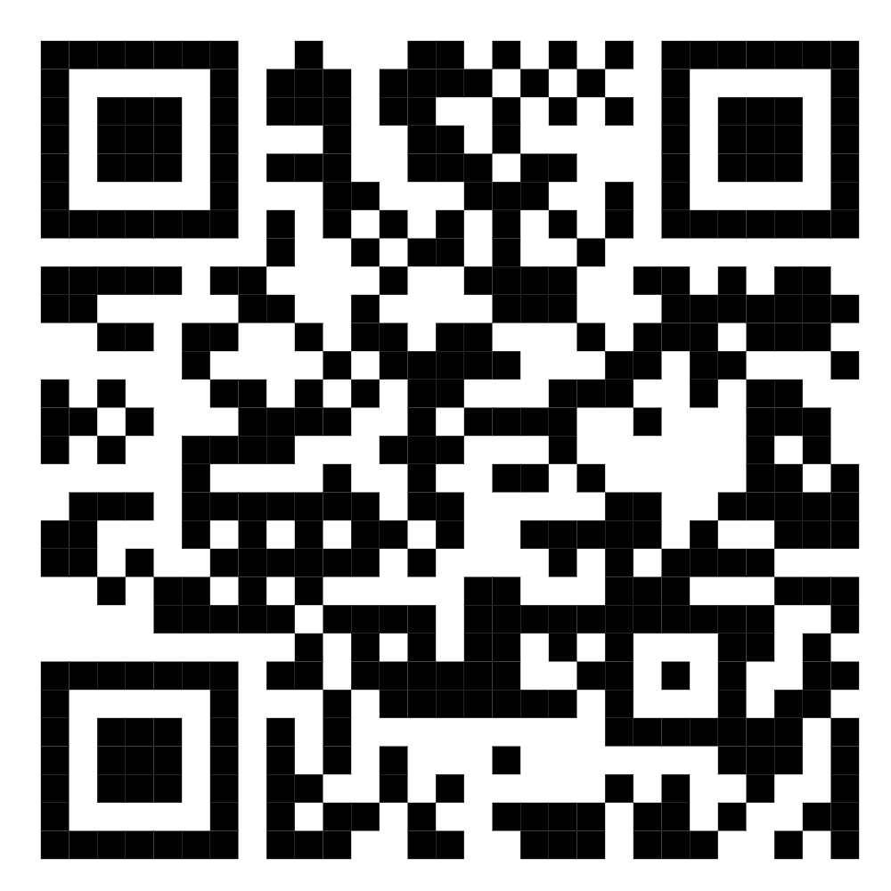
Nathan Clouse
Technical Architect
Caf2Code LLC
Microsoft Business Applications MVP 4X
www.atomicax.com
www.dynamics.fo
NathanClouseAX on LinkedIn, Twitter, few others

Slide 4
Overview
Automate with X++
Individual Task Model vs batch bundling vs top picking
Automate with C#
Automate with Azure

Slide 5
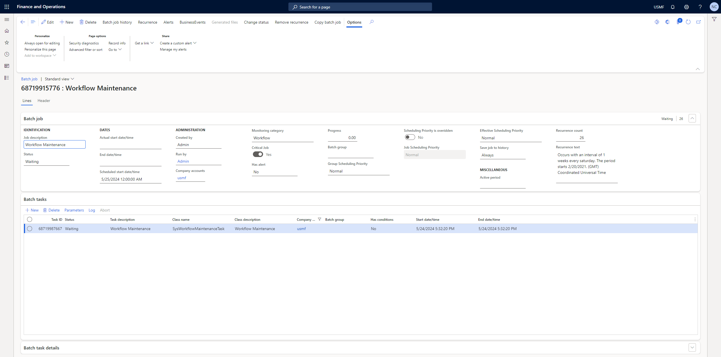
Batch System Overview

Slide 6
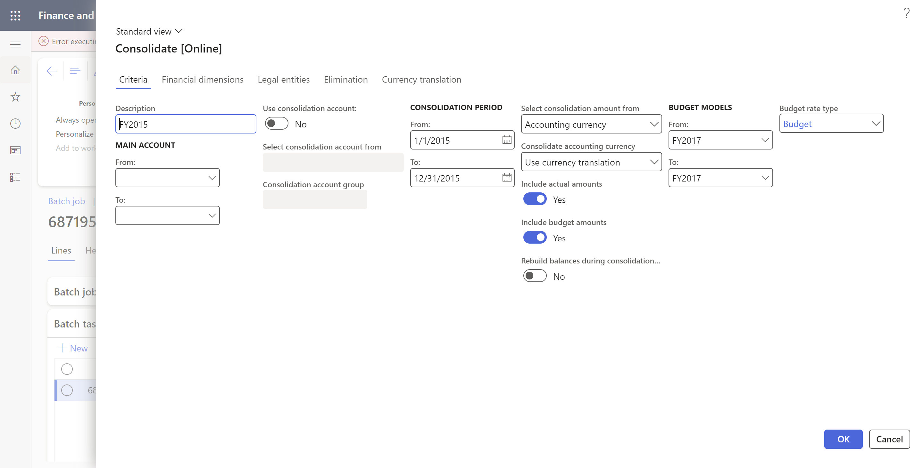
Batch System Overview

Slide 7

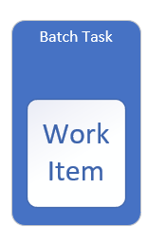
“Standard Batch Job”

Slide 8

“Standard Batch Job”
Simple
Easy to Create
Fast
Single Threaded
Single Worker

Slide 9
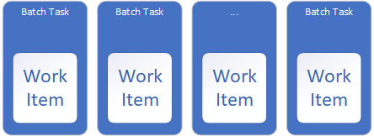
Individual Task Modeling

Slide 10
Individual Task Model – what is
Task for each work unit
1:1 relationship between work unit and task
More consistent work distribution because tasks are picked up by actor when actor has available ( aka batch capacity )
Upfront Overhead to create the tasks*
Each task execution has to check all preconditions if any for each and every task
Potential large number of tasks ( 10k + )
List pros and cons

Slide 11
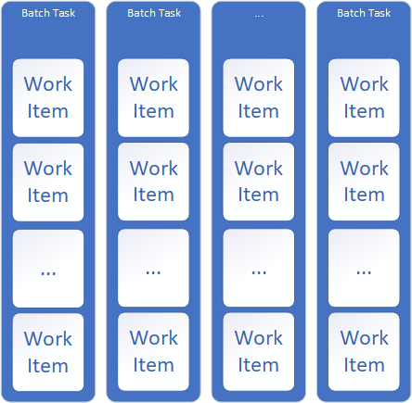
Batch Bundling
update

Slide 12
Batch Bundling
Static number of tasks
Split Work between tasks equally*
Work is grouped into bundles and each worker thread will process a bundle then pick up the next bundle
Good for use when each bundle will always be approximately the same amount of run time
Pros and cons, what is

Slide 13

Top Picking

Slide 14
Top Picking
Top Picking is intended to be a hybrid of Batch Bundling and Individual Task Modeling
Meant to help address uneven task distribution as well as overhead issues
Has similar issues as individual task modeling if number of work item records is large*
Use PESSIMISTICLOCK hint along with the READPAST hint

Slide 15
Top Picked Bundles Modelling

Slide 16
Top Picked Bundles Modelling
For large batch sizes
Combination of other methods
Modulus division is used for bundling

Slide 17
CHAPTER #2
C#

Slide 18
Use C# in X++
Use C# to do things X++ isn’t good at or can’t do
Typically see solutions are being either all X++ or push into F&O
Consider Pull
F&O isn’t always up
Minor drawback – thread cycling

Slide 19
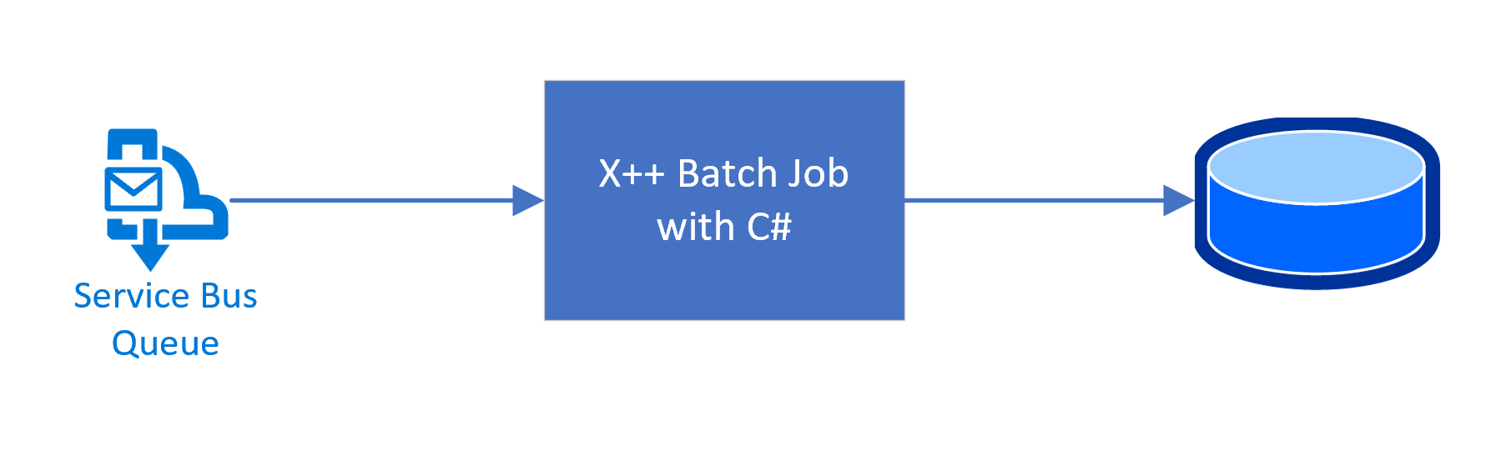
C# Pull Example

Slide 20
CHAPTER #3
Azure

Slide 21
F&O Tools
OData – synchronous real time
DMF API – async job scheduling
DMF Recurring Integrations – async capacity schedule
Custom Services – Do anything you want

Slide 22
Azure Tools
Logic Apps – Events based message transform and delivery. “low”ish “code”ish.
Function Apps – Event based code execution in various languages, like C#
Azure Data Factory – triggered set based processing, transform, and delivery
Also Power Automate

Slide 23
Questions?

Slide 24

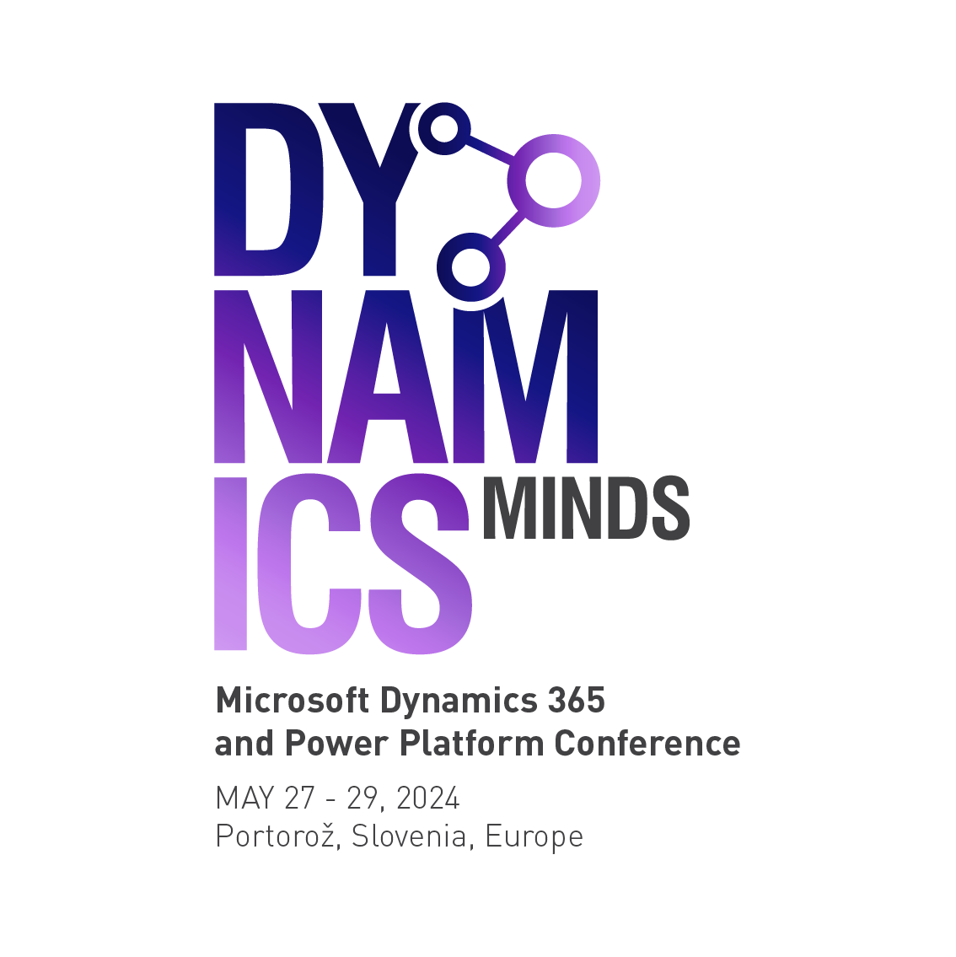



KEY DESIGN ELEMENTS

